Slide 1
SMART ANTENNA FOR BRAIN TUMOUR APPLICATION
By
BALAJI.R (211715106018)
BALAJI.V (211715106019)
BUVANESH.G (211715106022)
IV year, ECE,
UNDER THE GUIDANCE OF
Mrs.S.Kalaivani, M.E.,
Asst.Prof,
ECE, Dept.,

Slide 2
Introduction
Brain tumour is one of the most dangerous diseases that may affect the life of the human.
According to the statistics, 13.2 million deaths of tumour are expected in 2030.
Brain tumour is malignant or benign mass or growth of abnormal cells in the brain.
Magnetic Resonance Imaging (MRI), it is more dangerous for patients as it increase the cancer risk and it is very expensive.
In Computed Tomography (CT) scan there is a risk to patient because of high ionizing radiation dose and it is also very expensive.
Specific Absorption rate technique mainly concentrate on the absorption rate between the healthy and defected brain cells. Also SAR based techniques are accurate, cost effective.

Slide 3
Objective
To design and fabricate the Microstrip Patch antenna for the desired frequency range of 2.4 – 2.7GHz.
To analyse the Specific Absorption Rate from the obtained parameters, in order to detect the presence of tumour we model the head phantom with tumour and without tumour with the help of CST software.

Slide 4
Literature Review
S.NO | TITLE | YEAR | AUTHOR NAME | JOURNAL NAME | REMARKS
1 | UWB Antenna for Brain stroke and Brain Tumour Detection | 2016 | M.A. Shokry, Prof. Dr.A.M.M.A. Allam | Electromagnetic field computation (IEEE) | There is a good agreement between the measured and simulated results of the return loss of the antenna on human’s head and head phantom. We can only detect the presence of brain tumour with radius 24.6mm and above.

Slide 5
Literature Review
S.NO | TITLE | YEAR | AUTHOR NAME | JOURNAL NAME | REMARKS
2 | An Antenna for Microwave Brain Imaging | 2015 | Adhitya Satria Pratama, Basari*, Muhammad Firdaus S. Lubis, Fitri Yuli Zulkifli, Eko Tjipto Rahardjo | Antennas and Propagation (IEEE) | This antenna is a printed dipole fed by a coplanar waveguide it provides high frequency response The entire desired working frequencies can be covered by adding perturbation on antenna structure.

Slide 6
Literature Review
S.NO | TITLE | YEAR | AUTHOR NAME | JOURNAL NAME | DEMERITS
3 | Optimization of Vivaldi Antenna for Tumour Detection | 2013 | Mohammed A. Alzabidi, Maged A. Aldhaeebi and Ibrahim Elshafiey | Artificial Intelligence, Modelling & Simulation (IEEE) | The antenna is immersed in background of relative permittivity 40 to achieve good matching with the head tissue. Results show that good performance is obtained. With the increase of frequency of operation, the resolution is enhanced, while the energy penetration is reduced. There is thus a trade-off between these two.

Slide 7
Literature Review
S.NO | TITLE | YEAR | AUTHOR NAME | JOURNAL NAME | REMARKS
4 | Microwave Imaging for Brain Tumour Detection Using an UWB Vivaldi Antenna Array November | 2012 | Haoyu Zhang, Brian Flynn, Ahmet T. Erdogan, Tughrul Arslan | Loughborough Antennas & Propagation (IEEE) | The impulse intensity is employed to represent the tumour location since the antenna array rotates 1.5° for each step which offers enough precision for image processing. Antenna array rotates far away from the tumour, only a few sets of data can be collected since the tumour reflections are very weak around there.

Slide 8
Literature Review
S.NO | TITLE | YEAR | AUTHOR NAME | JOURNAL NAME | REMARKS
5 | A Smart Antenna Array for Brain Cancer Detection | 2011 | Haoyu Zhang, Ahmed O. El-Rayis, Nakul Haridas, Nurul H. Noordin, Ahmet T. Erdogan, Tughrul Arslan | Loughborough Antennas & Propagation (IEEE) | The antenna array is composed of three ultra-wideband Vivaldi antennas which have relatively small dimensions and provide good performance. The response of brain with tumor and without tumour have similar profile only amplitude of brain with tumour is slightly greater than others.

Slide 9
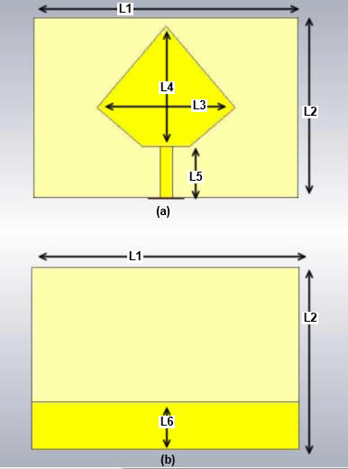
EXISTING MODEL
An UWB Pentagon antenna is designed to detect brain stroke and brain tumour. It is operating at a band from 3.3568-12.604 GHz in free space and from 3.818 to 9.16 GHz on the normal head model.
The head phantom with conductivity and permittivity as that of the human head was analysed by the signal transmitted and received from the antenna.

Slide 10
Existing Model
It is an Microstrip Patch Antenna with very high Operating frequency 3.3568-12.604 GHz in free space and from 3.818 to 9.16 GHz on the normal head model.
This may cause the patient headache and nausea.
The antenna is also complex to design and operate.

Slide 11
Proposed Model
A Microstrip patch antenna, was designed and simulated on the CST Microwave Studio.
The free space testing was done with the designed antenna and its S-Parameter, gain were measured.
Then an head phantom model which is having the conductivity and permittivity same as that of the human’s head was designed using the CST 2018 software.

Slide 12
Flow Chart of Proposed Model
Frequency Selection
Antenna Type and Design
Calibration
Antenna
Working and Error Check
Sam Phantom without Tumour
Sam Phantom with Tumour
SAR
Report
SAR
Report

Slide 13
Frequency Selection
The operating frequency of our antenna is around 2.4GHz to 2.7 GHz.
Its is a low gain antenna with a gain of -10dB gain at 2.55GHz of frequency.

Slide 14
Antenna Type and Design
The antenna used here is a Microstrip Patch antenna which is made up of Copper and Stainless steel because of its cost efficient property.
The antenna is designed in the form of “E”, “B” and “G”.
The feed given to this antenna is co-axial feed which is the commonly used feeding method and the most effective one in microstrip patch antenna.
The total length and breath of the antenna is 50x50mm and thickness is 2mm.

Slide 15
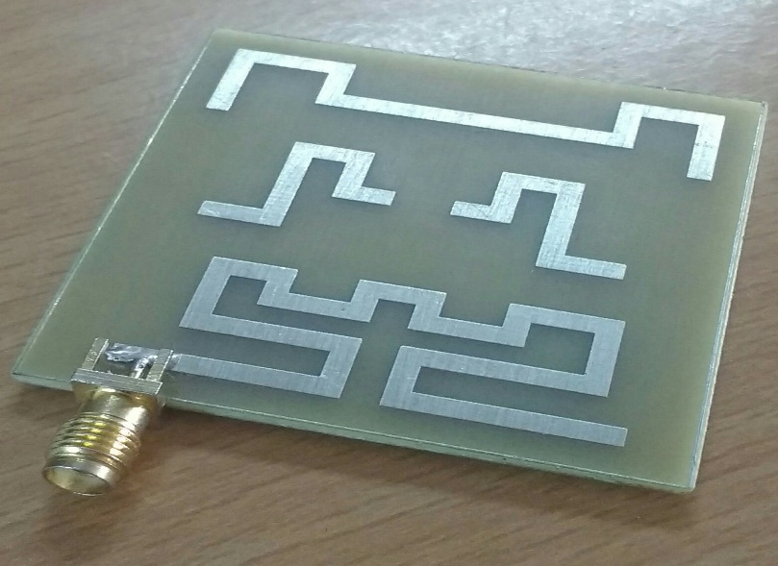
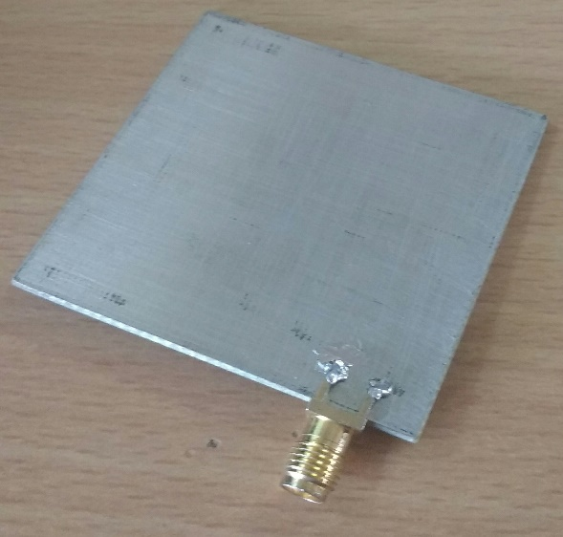
Antenna Type and Design Cont.,
Patch | Length (mm)
E | 169
B | 39
G | 82

Slide 16
Calibration
This method is done in hardware to ensure that there is no error in the Network Analyzer to which the Microstrip antenna is connected through the feeding point. There are three different components in it they are,
Load,
Short,
Open.

Slide 17
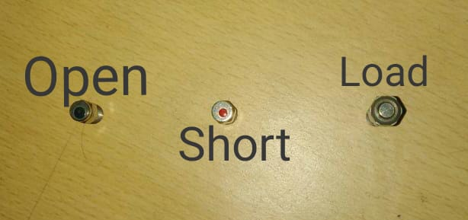
Calibration Cont.,
Calibration | Resistance (ohms)
Load | 50
Short | 0
Open | infinite

Slide 18
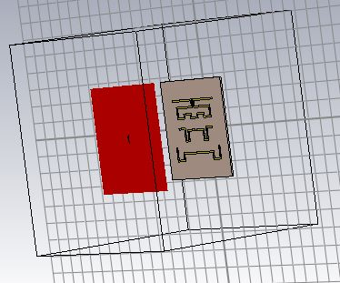
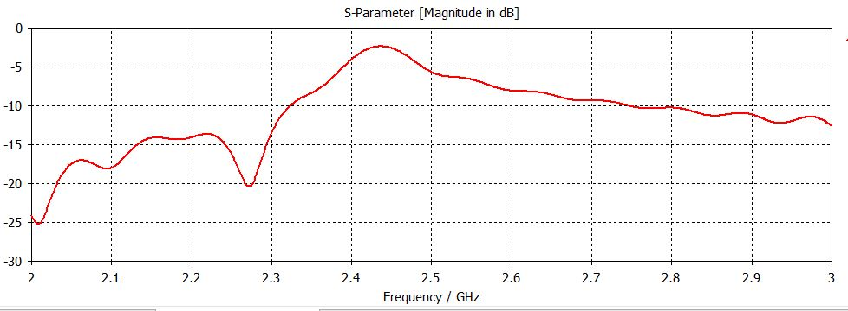
Working and Error Check
Before working with human head model, the antenna is checked for zero error and if the error is found the error is eliminated using bit error rate.

Slide 19
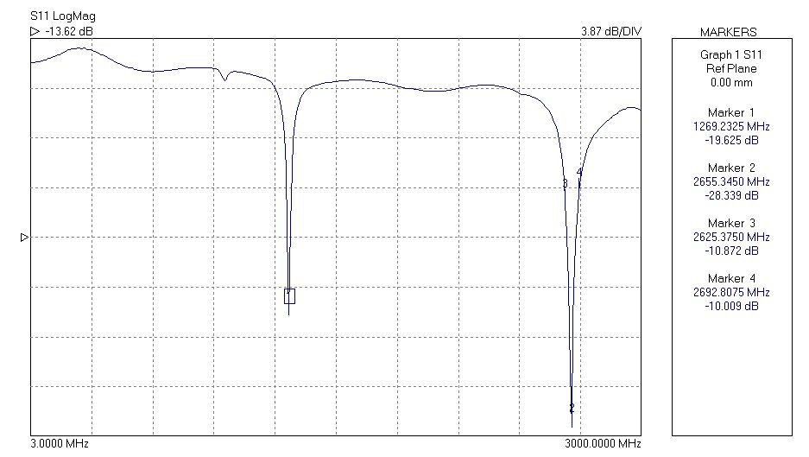
Working and Error Check Hardware

Slide 20
Working and Error Check Software

Slide 21
Sam Phantom without Tumour
Here the antenna is placed at a distance of 60mm or 6 cm because the most effective radiance distance covered by it is at 60mm from the antenna. This helps the SAR calculation to have a maximum SAR point of 1.6W/kg or above which is widely required for the detection of Brain tumour in the human head.

Slide 22
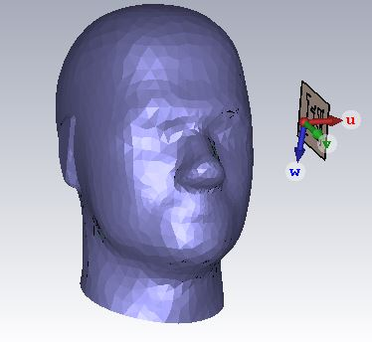
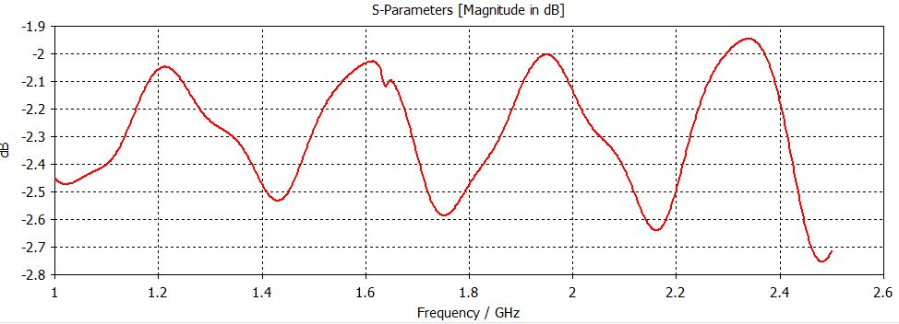
Sam Phantom without Tumour

Slide 23
Sam Phantom with Tumour
Here the antenna is placed at a distance of 60mm or 6 cm because the most effective radiance distance covered by it is at 60mm from the antenna. This helps the SAR calculation to have a maximum SAR point of 1.6W/kg below which is widely required for the detection of Brain tumour in the human head.
The tumour used here is a tissue collective.

Slide 24
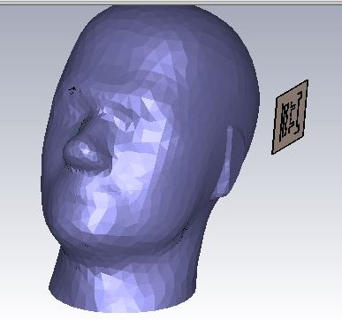
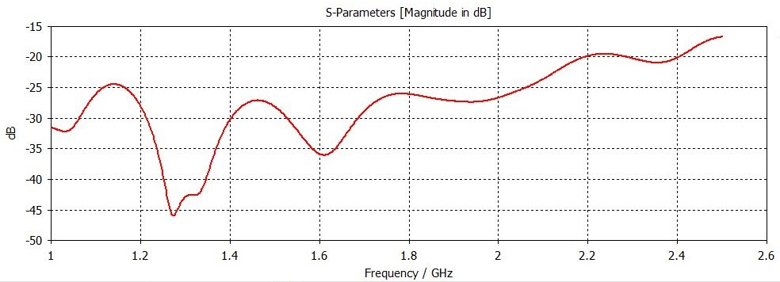
Sam Phantom with Tumour

Slide 25
Experimental results and discussion
The SAR Specific Absorption Rate is the main parameter we required to identify the presence of tumour in the brain.
As we start the stimulation we can get the SAR Report after completion of the process.

Slide 26
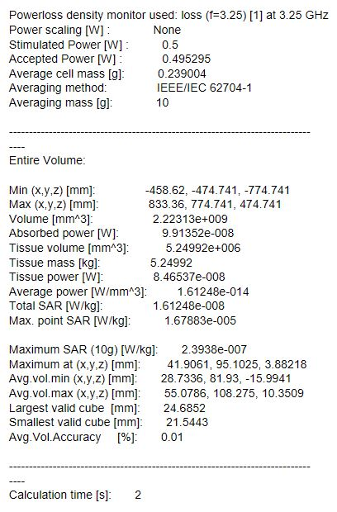
Sam Phantom without Tumour
This is the SAR Specific Absorption Rate report of Sam Phantom with tumour which shows the Max. SAR point in around 1.6 W/Kg

Slide 27
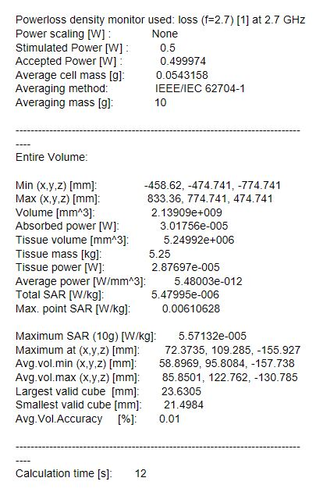
Sam Phantom with Tumour
This is the SAR Specific Absorption Rate report of Sam Phantom with tumour which shows the Max. SAR point in less than 1.6 W/Kg

Slide 28
Conclusion
The human head phantom is designed with and without tumour, tested with the proposed antenna. The various response (with and without tumour) observed by the antenna and analyzed using CST software. From the response of simulated Specific absorption rate, we analyzed the statistical differences between the normal head and the head that contains tumor. From these results we were able to accurately find the presence of tumour.

Slide 29
References
[1] B. J. Mohammed, A. M. Abbosh, S. Mustafa, and D. Ireland, "Microwave
system for head imaging," Instrumentation and Measurement, IEEE
Transactions on, vol. 63, pp. 117-123, 2014.
[2] o. N.-I. R. H. IEEE Standards Coordinating Committee 28, IEEE Standard
for Safety Levels with Respect to Human Exposure to Radio Frequency
Electromagnetic Fields, 3kHz to 300 GHz: Institute of Electrical and Electonics
Engineers, Incorporated, 1992.
[3] A. Sabouni and A. Kishk, "Dual-polarized, broadside, thin dielectric
Resonator antenna for microwave imaging," Antennas and Wireless
Propagation Letters, IEEE, vol. 12, pp. 380-383, 2013.
[4] A. T. Mobashsher, A. M. Abbosh, and Y. Wang, "Microwave system to
detect traumatic brain injuries using compact unidirectional antenna and
wideband transceiver with verification on realistic head phantom," Microwave
Theory and Techniques, IEEE Transactions on, vol. 62, pp. 1826-1836, 2014.
[5] X. Li, M. Jalilvand, Y. L. Sit, and T. Zwick, "A compact double-layer onbody matched bowtie antenna for medical diagnosis," Antennas and
Propagation, IEEE Transactions on, vol. 62, pp. 1808-1816, 2014.
[6] A. T. Mobashsher and A. Abbosh, "Slot-loaded folded dipole antenna with
wideband and unidirectional performance for L-band applications," Antennas
and Wireless Propagation Letters, IEEE, vol. 13, pp. 798-801, 2014.

Slide 30
References
[7] S. Ahdi Rezaeieh and A. Zamani, "3-D Wideband Antenna for HeadImaging System with Performance Verification in Brain Tumor Detection,"
Antennas and Wireless Propagation Letters, IEEE, vol. 14, pp. 910-914, 2015.
[8] C. Chiu, H. Wong, and C. Chan, "Study of small wideband folded-patchfeed antennas," IET Microwaves, Antennas & Propagation, vol. 1, pp. 501-505,
2007.
[9] T. Taga and K. Tsunekawa, "Performance Analysis of a Built-In Planar
Inverted F Antenna for 800 MHz Band Portable Radio Units," IEEE Journal on
Selected Areas in Communications, vol. 5, pp. 921-929, 1987.
[10] W.-L. Chen, G.-M. Wang, and C.-X. Zhang, "Bandwidth enhancement
of a microstrip-line-fed printed wide-slot antenna with a fractal-shaped slot,"
Antennas and Propagation, IEEE Transactions on, vol. 57, pp. 2176-2179,
2009.
[11] S. Ahdi Rezaeieh, A. Abbosh, and Y. Wang, "Wideband unidirectional
antenna of folded structure in microwave system for early detection of
congestive heart failure," Antennas and Propagation, IEEE Transactions on,
vol. 62, pp. 5375-5381, 2014.
[12] C. M. Kruesi, R. J. Vyas, and M. M. Tentzeris, "Design and development
of a novel 3-D cubic antenna for wireless sensor networks (WSNs) and RFID
applications," Antennas and Propagation, IEEE Transactions on, vol. 57, pp.
3293-3299, 2009.

Slide 31
References
[13] S. Ahdi Rezaeieh, A. Zamani, and A. Abbosh, "3-D Wideband Antenna
for Head-Imaging System with Performance Verification in Brain Tumor
Detection," IEEE Antennas and Wireless Propagation Letters, vol. 14, pp. 910-
914, 2015.
[14] K. Foster, J. Schepps, R. Stoy, and H. P. Schwan, "Dielectric properties
Of brain tissue between 0.01 and 10 GHz," Physics in medicine and biology,
vol. 24, p. 1177, 1979.
[15] S. Gabriel, R. Lau, and C. Gabriel, "The dielectric properties of biological
tissues: II. Measurements in the frequency range 10 Hz to 20 GHz," Physics in
medicine and biology, vol. 41, p. 2251, 1996.
[16] A. Peyman, S. Holden, S. Watts, R. Perrott, and C. Gabriel, "Dielectric
properties of porcine cerebrospinal tissues at microwave frequencies: in vivo,
in vitro and systematic variation with age," Physics in medicine and biology,
vol. 52, p. 2229, 2007.
[17] M. Jalilvand, X. Li, L. Zwirello, and T. Zwick, "Ultra wideband compact
near-field imaging system for breast cancer detection," IET Microwaves,
Antennas & Propagation, 2015.
[18] R. K. Amineh, M. Ravan, A. Trehan, and N. K. Nikolova, "Near-field
microwave imaging based on aperture raster scanning with TEM horn
antennas," Antennas and Propagation, IEEE Transactions on, vol. 59, pp. 928-
940, 2011.

Slide 32
References
[19] B. Menze et al., “The multimodal brain tumour image segmentation benchmark (brats),” IEEE Transactions on Medical Imaging, vol. 34, no. 10, pp. 1993–2024, 2015.
[20] Pereira, S., Pinto, A., Alves, V., et al.: ‘Brain tumour segmentation using convolutional neural networks in MRI images’, IEEE Trans. Med. Imaging, vol, 35, pp. 1240–1251,2016.

Slide 33
Thank You

